Slide 1

Work related learning
Sagar Poudel

Slide 2
Introduction
Name: Sagar Poudel
ID : 18030043
Supervisor Name: Ravi Chandra Gurung
Course: Work Related Learning
Name: Group Phoenix Pvt. Ltd.
Supervisor Name: Pradip Pokhrel
Position: Organization Incharge
Student
Academic
Company

Slide 3
My position and work in group phoenix
Role: Laravel Developer Intern
Work: My supervisor had assigned me to complete a project like inventory system named as Restro Point of Sales system which has feature of Insertion, Deletion, Update of Customer and Item data along with additional feature of doing sales and printing bill.

Slide 4
Learning Outcomes
LO1 : Development of Web development Skill (Laravel)
LO2 : Enhancing research skills for Laravel
LO3 : Development of user interface designs
LO4 : Team Working Skill
LO5 : Development in Presentation Skill
LO6 : Discussing and generating new ideas along with implementing it.
LO7 : Getting knowledge of HTML, CSS and JavaScript

Slide 5
How I achieved those learning outcomes?
LO1 : Working on project (Restro POS system) related to Laravel.
LO2 : Searching related research papers and websites.
LO3 : Designing UI for Project.
LO4 : Working in team while developing project.
LO5 : Presenting Project to supervisor.
LO6 : Discussing ideas and implementing ideas on project.
LO7 : Working on project related to HTML, CSS and JavaScript.

Slide 6
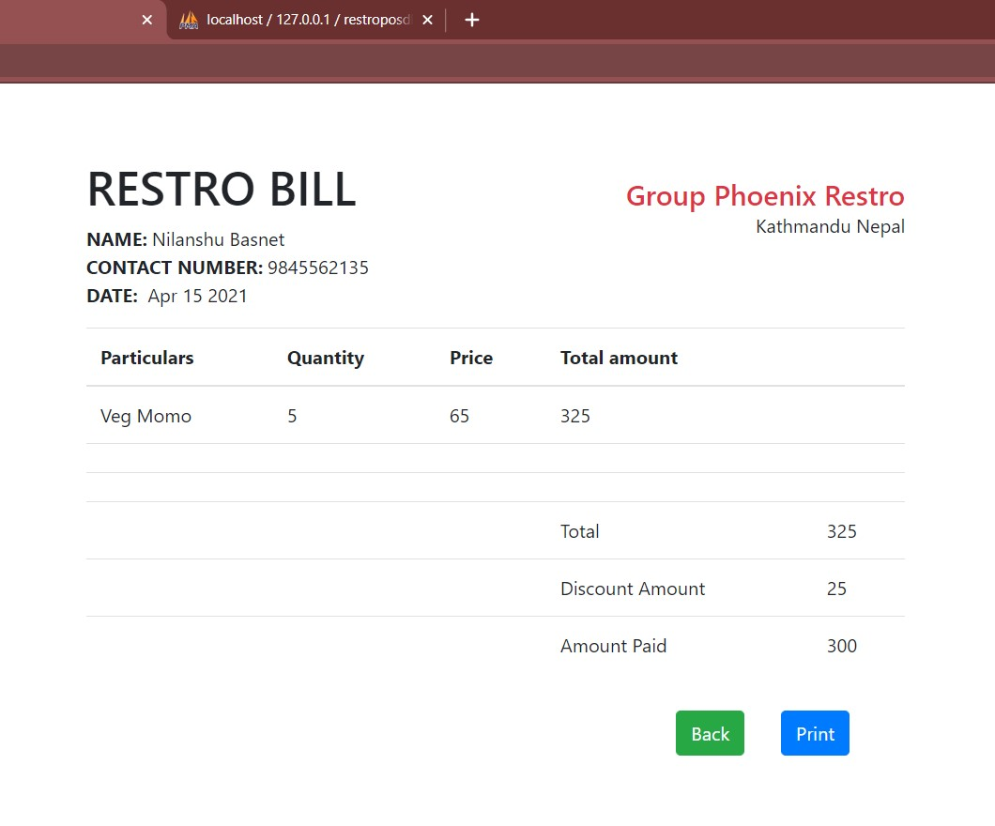
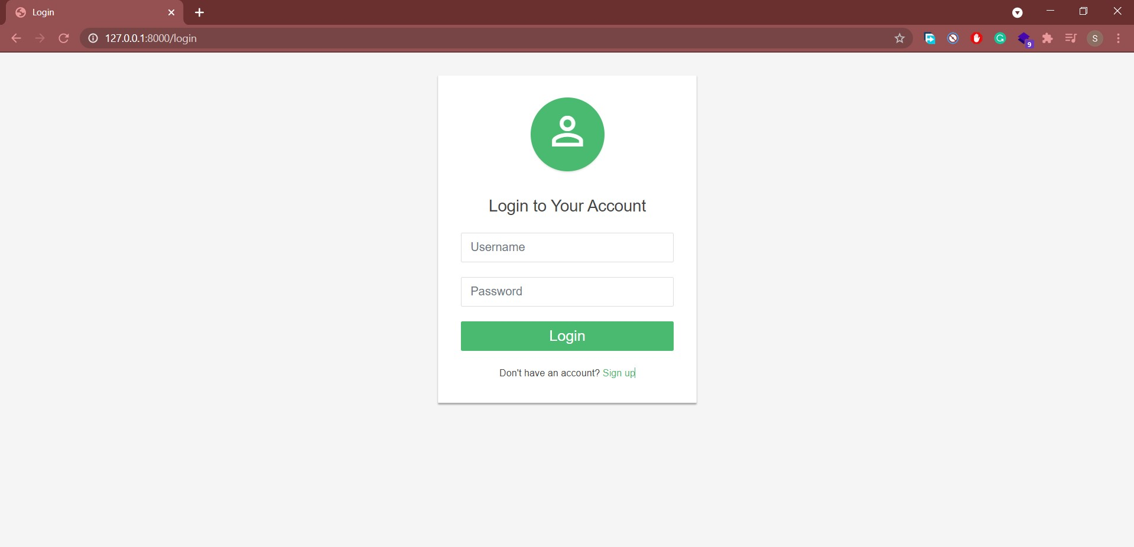
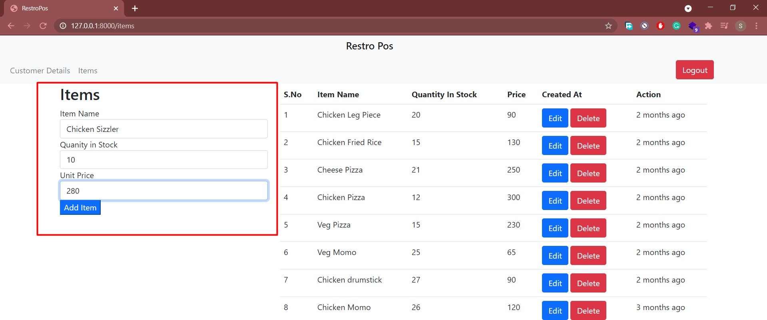
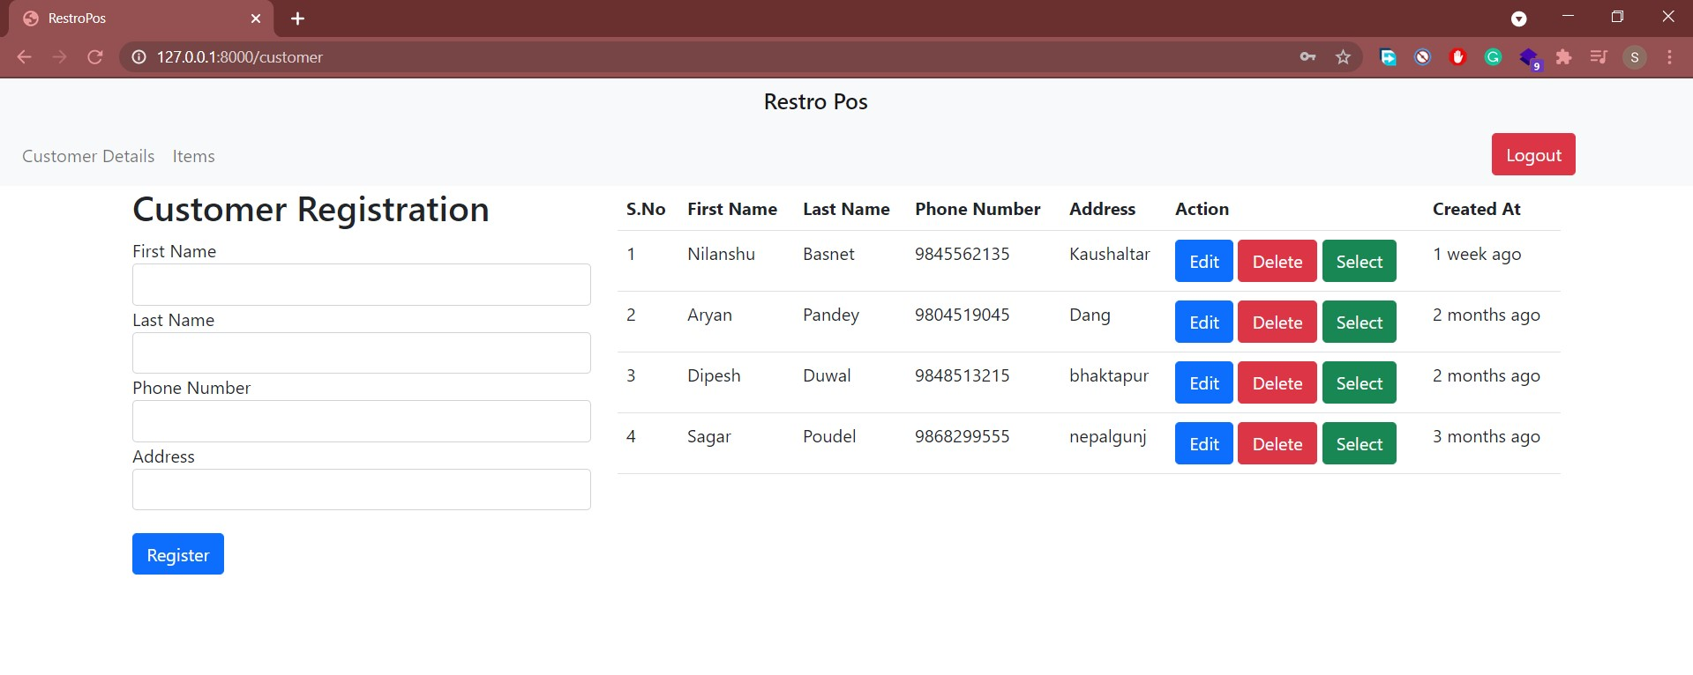
Sample Evidences for LO1
Screenshots of project

Slide 7
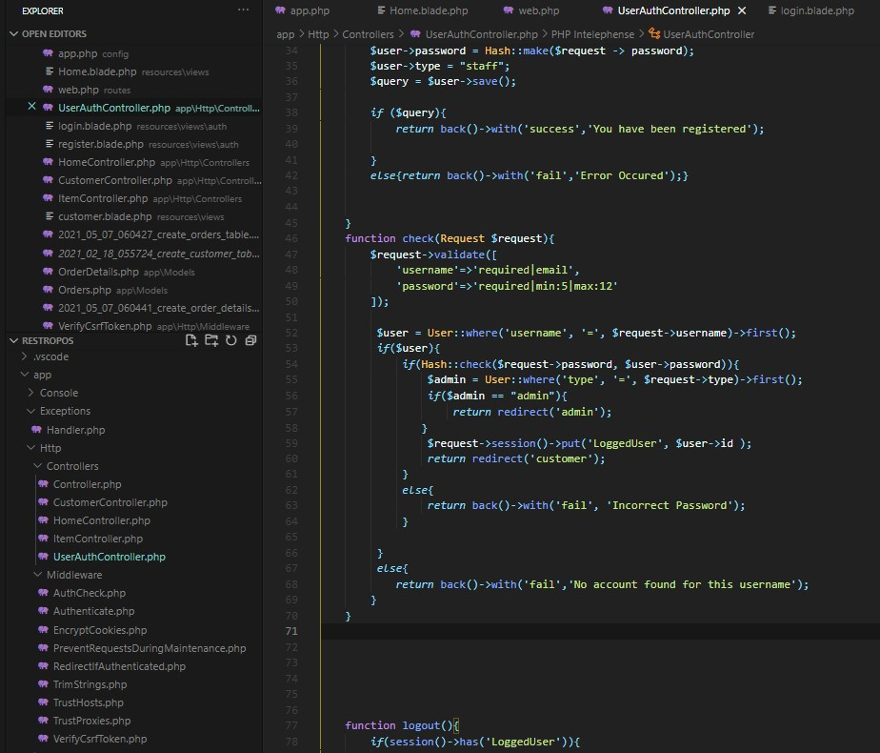
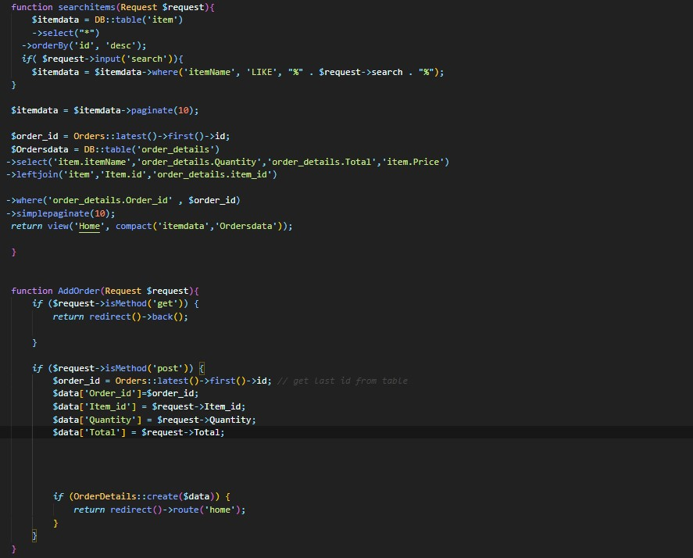
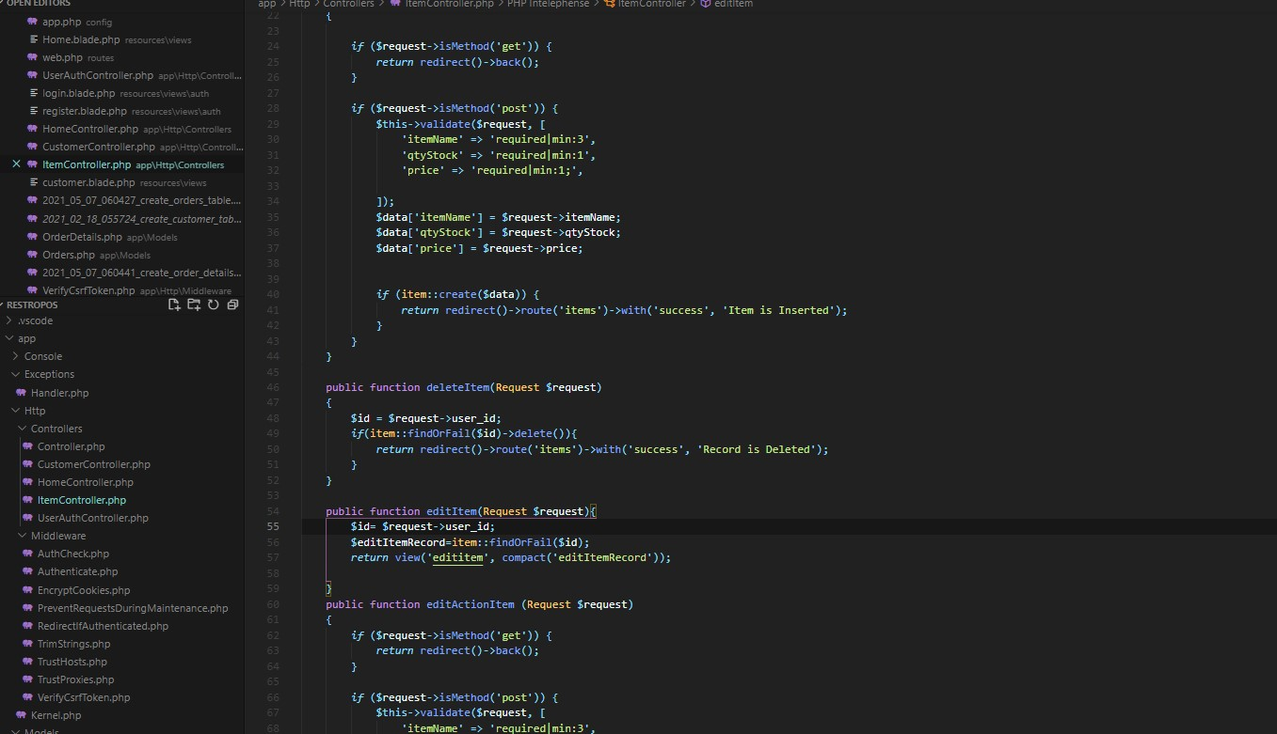
Sample Evidences for LO1
Screenshots of code (Zoom in for clear view)

Slide 8
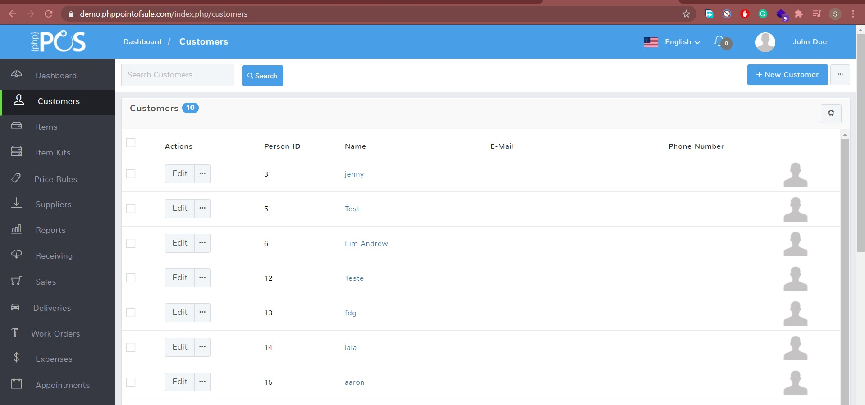
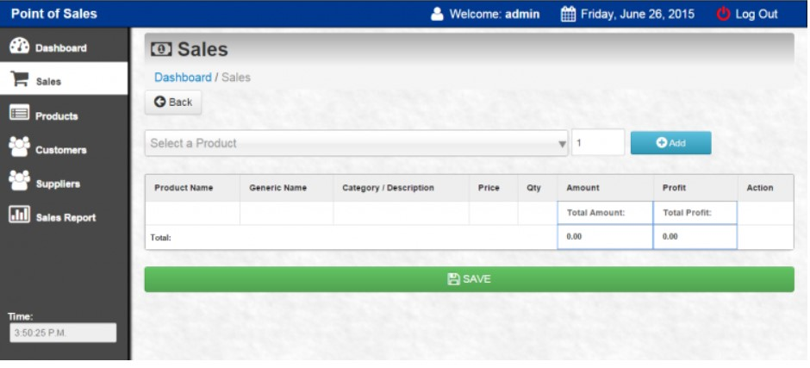
Sample Evidences for LO2
Screenshots of researched websites

Slide 9
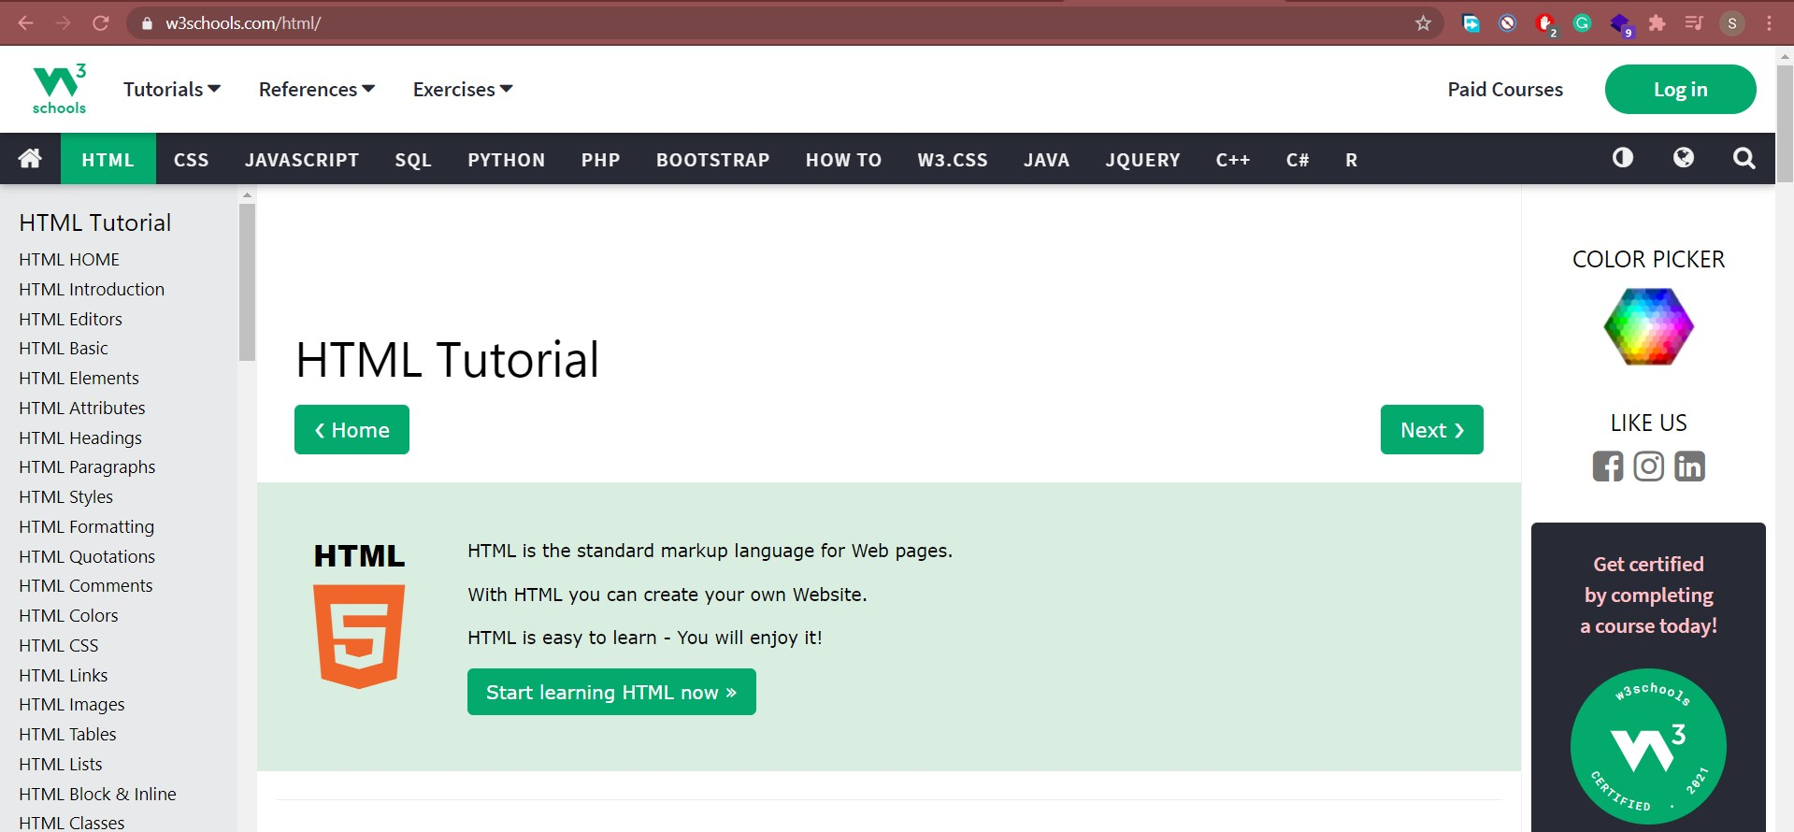
Sample Evidences for LO2
Screenshots of researched websites

Slide 10
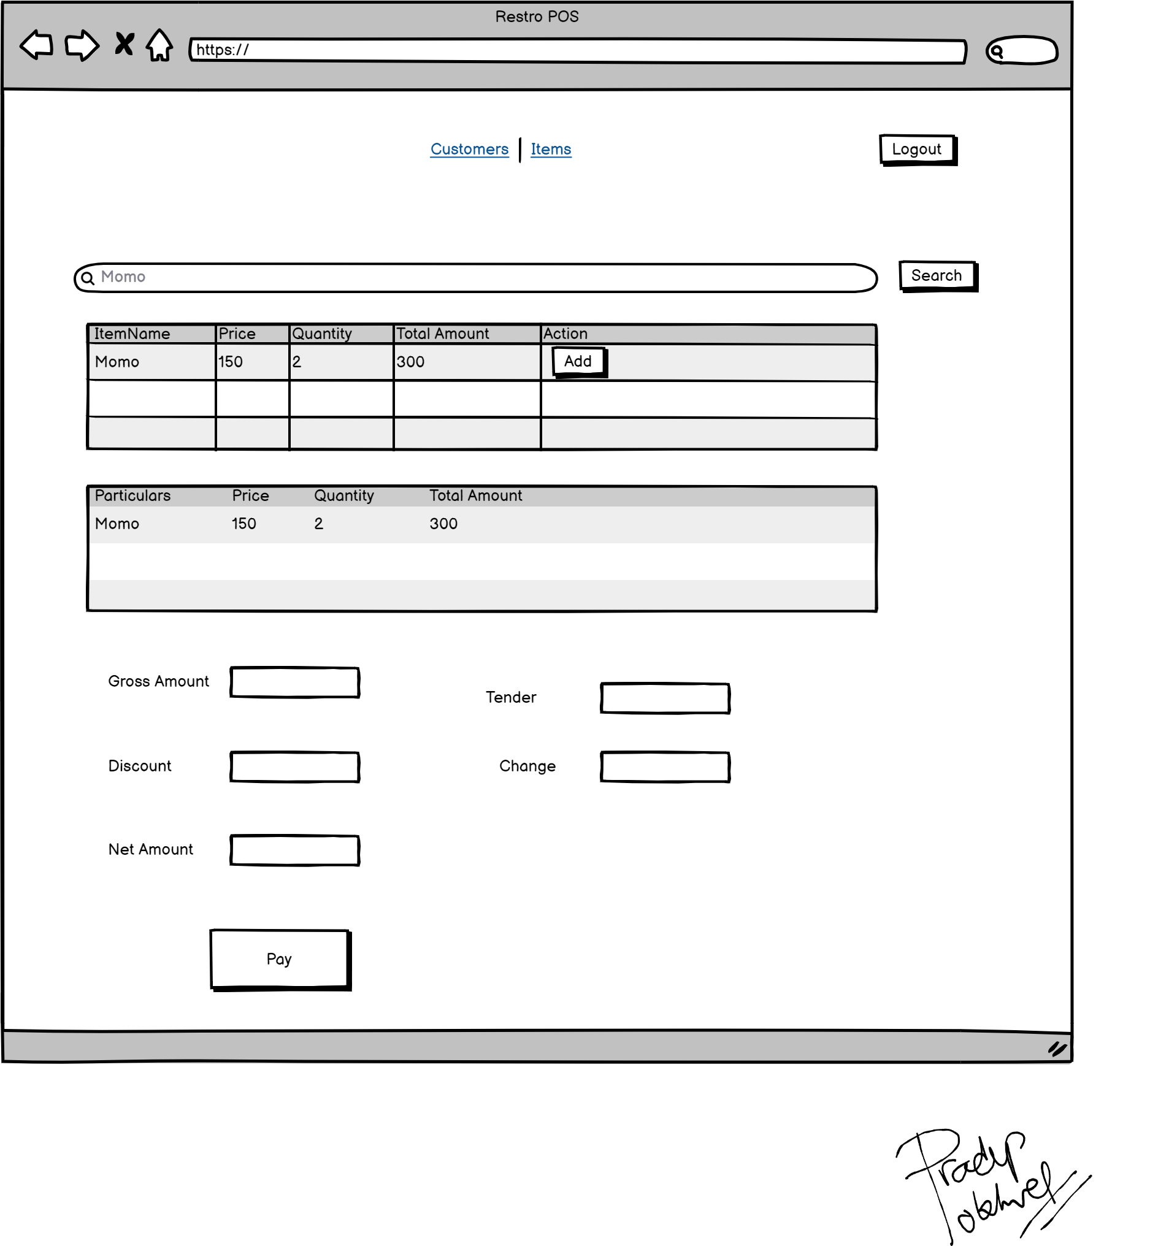
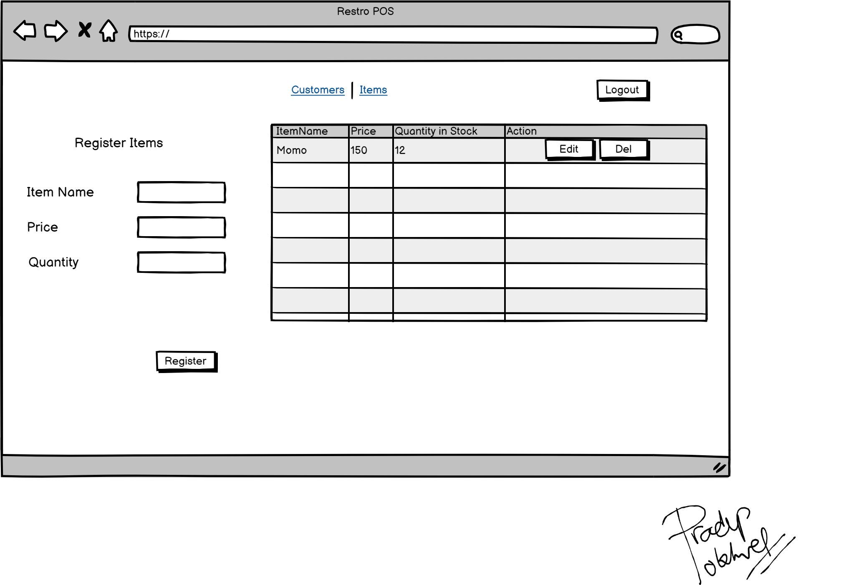
Sample Evidences for LO3
Screenshots of Wireframes

Slide 11
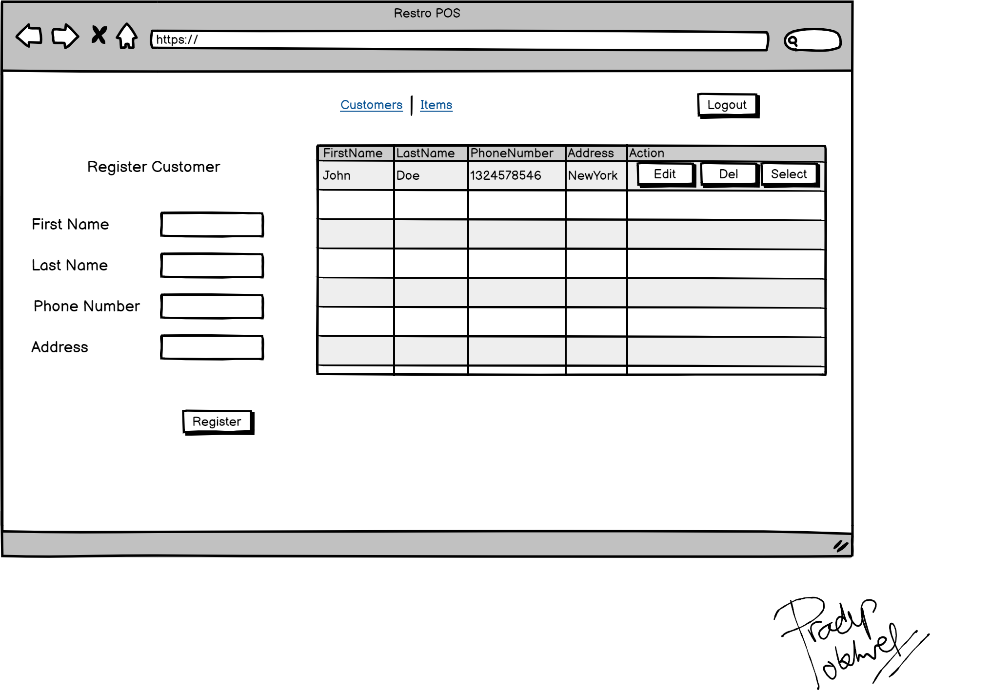
Sample Evidences for LO3
Screenshots of Wireframes

Slide 12
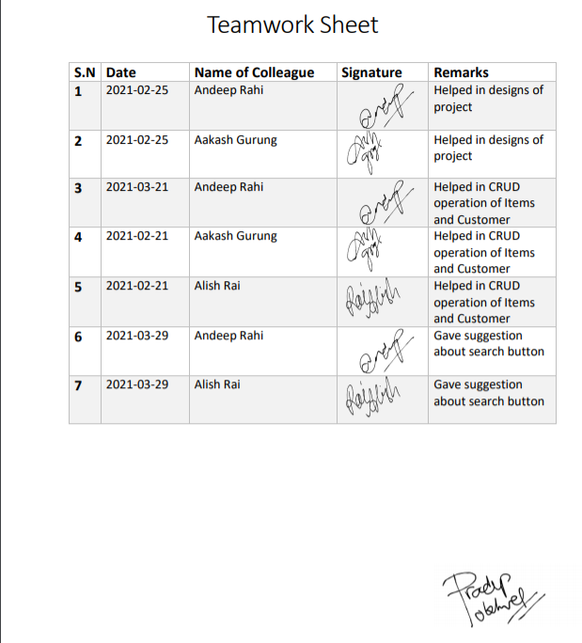
Sample Evidences for LO4
Teamwork Sheet

Slide 13

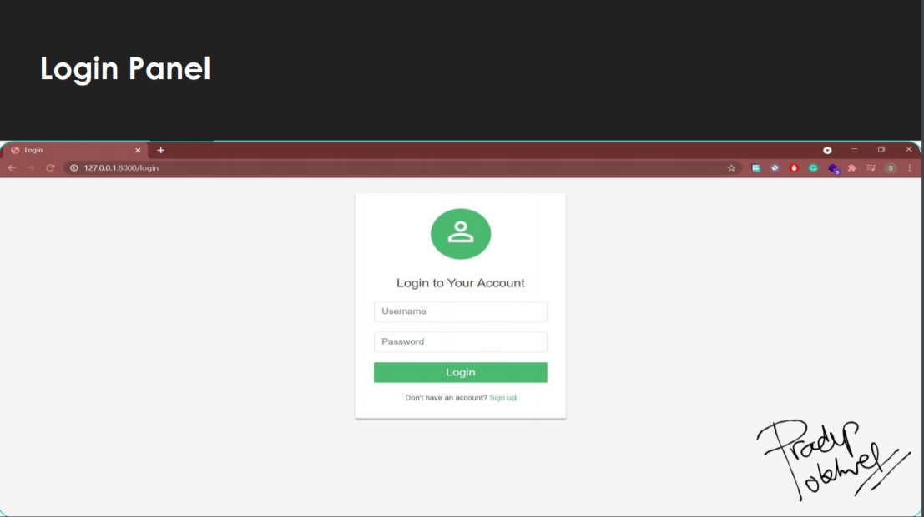
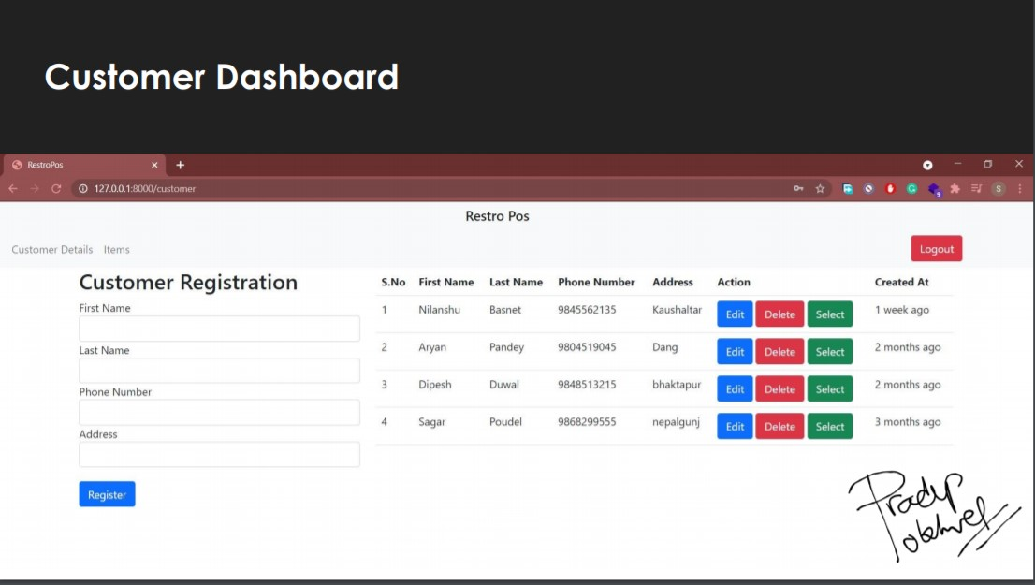
Sample Evidences for LO5
Presentation Slides

Slide 14
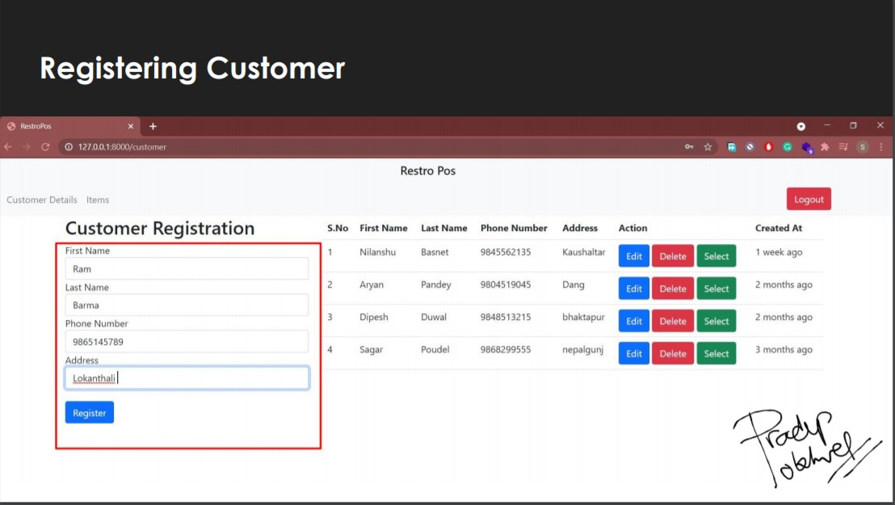
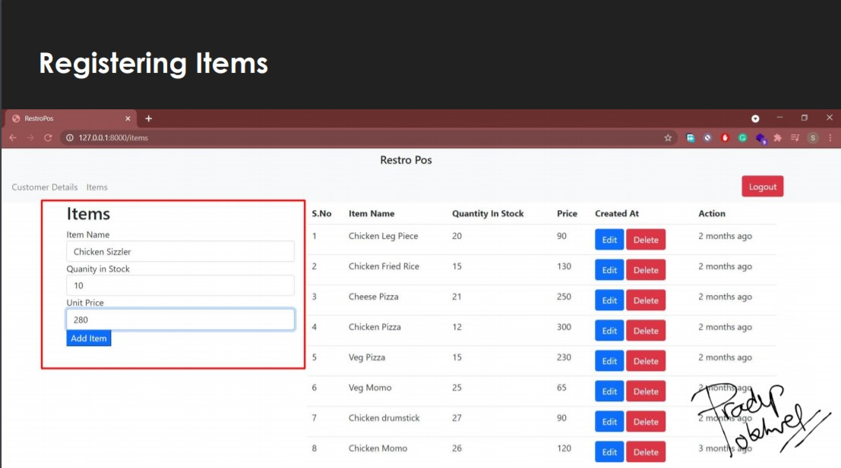
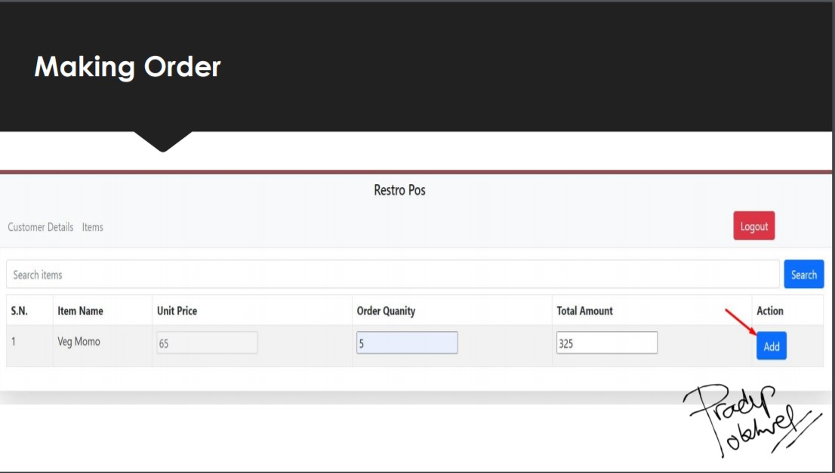
Sample Evidences for LO5
Presentation Slides

Slide 15
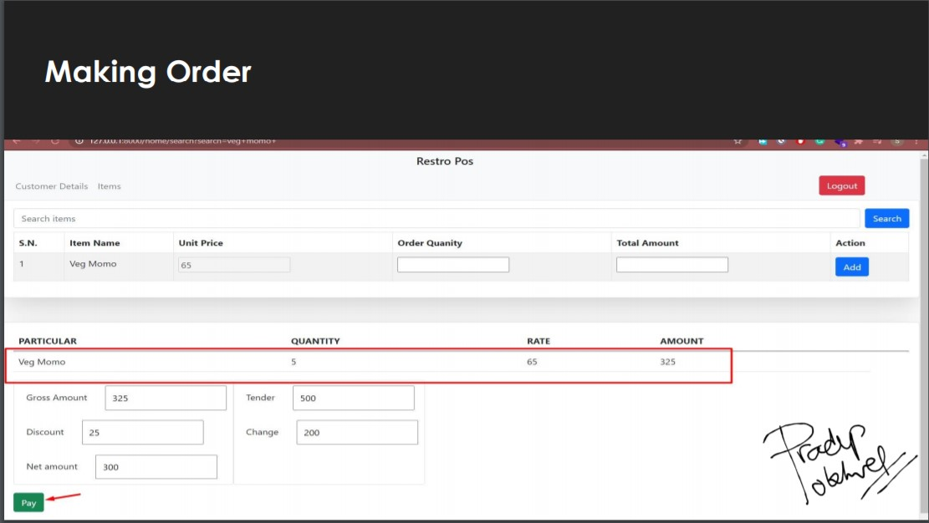
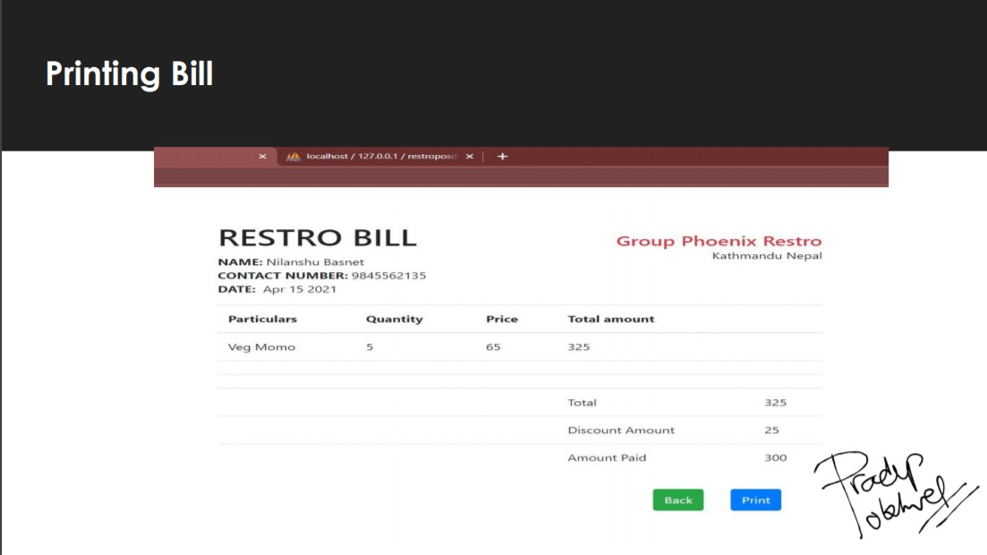

Sample Evidences for LO5
Presentation Slides

Slide 16
Sample Evidences for LO6
Screenshot of Implemented Idea(Restro Bill)

Slide 17
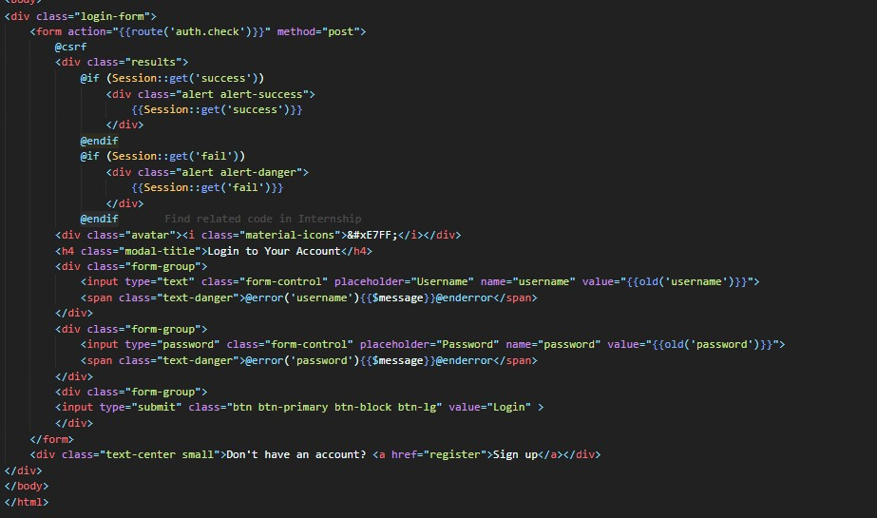
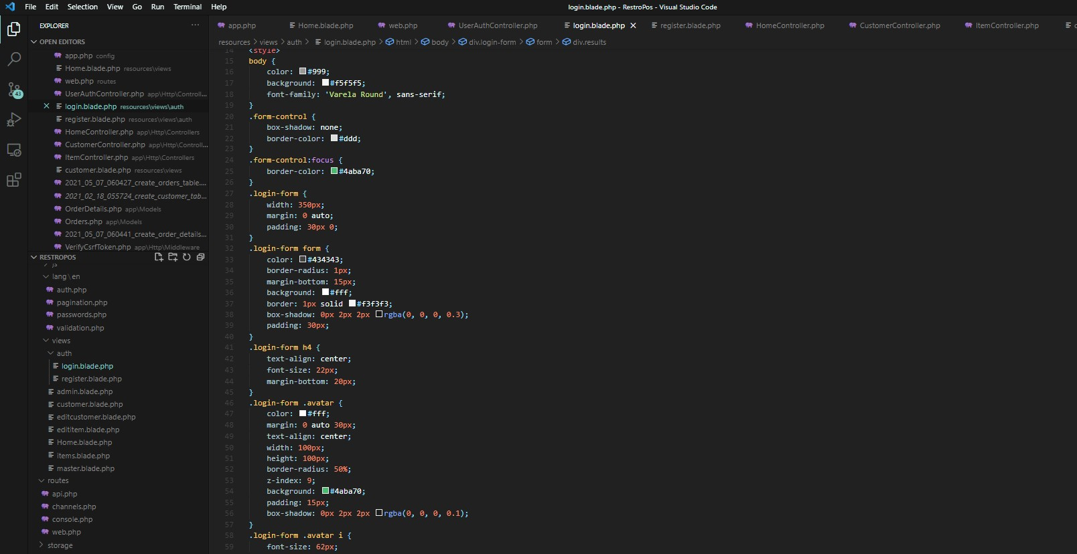
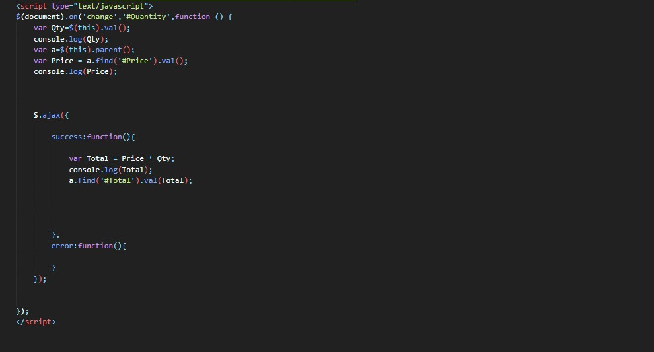
Sample Evidences for LO7
Screenshot of Code(Zoom in for Better View)

Slide 18
Problems Encountered
1. Being Familiar to all colleague in short period was one of the difficulties for me.
2. Asking for help in project for first time from colleague was also a problem.
3. One of the main challenges I faced was in designing part as my design was rejected for several times.
4. Inserting Search Function in Items sales was also a burden for me as it was new to me, but my colleagues helped me out.

Slide 19
What did I enjoy?
1. Working and Learning with Group Phoenix
2. Friendly colleagues who gave me valuable suggestions during my project development
3. Good mentorship by supervisor as he act as a mentor rather than supervisor which helped me a lot in boosting my enthusiasm and confidence.

Slide 20
Future Plan
1. To learn more about Laravel Framework
2. To make websites for small scale business in my locality
3. To make Student Management System using Laravel for my own institute in my hometown.
4. To start Blog site using HTML, CSS and JS as frontend and Laravel as backend.

Slide 21

End

